Slide 1

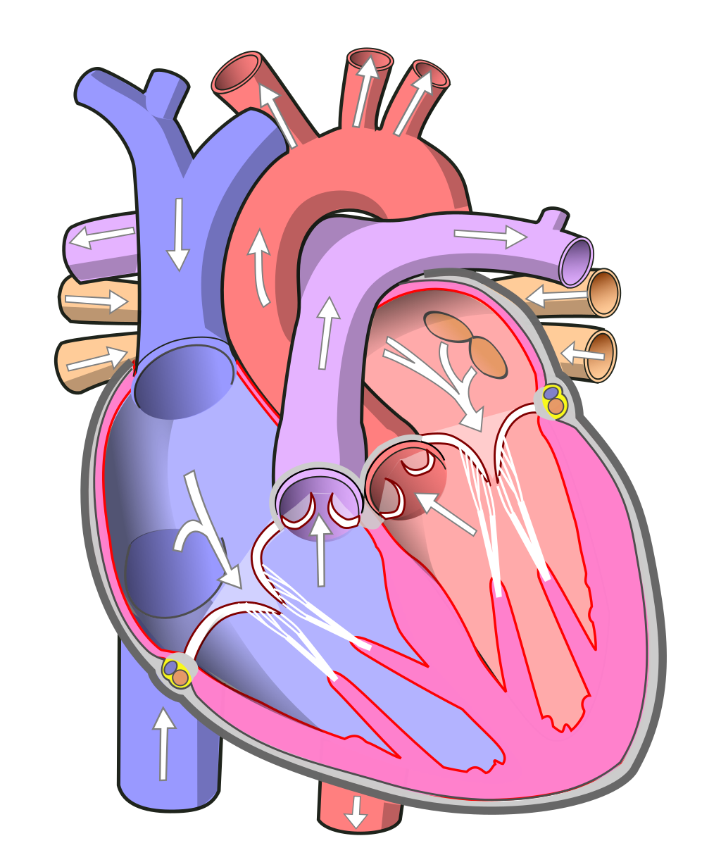
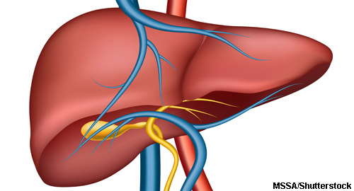
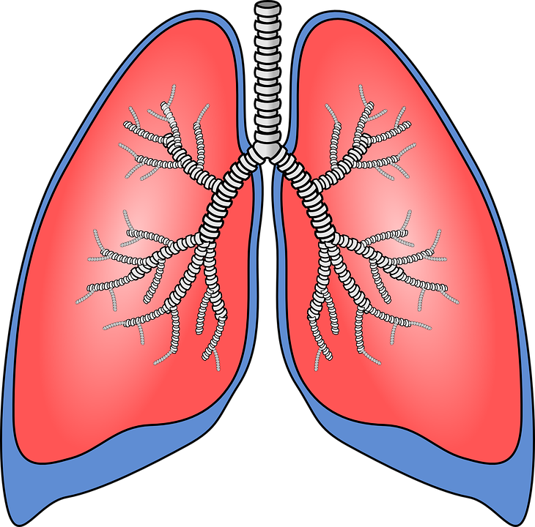
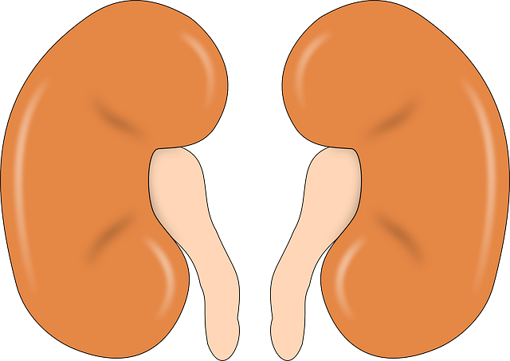
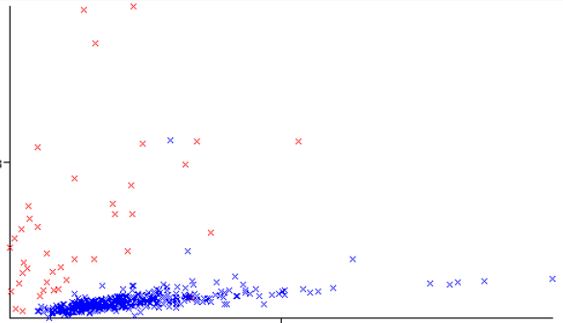
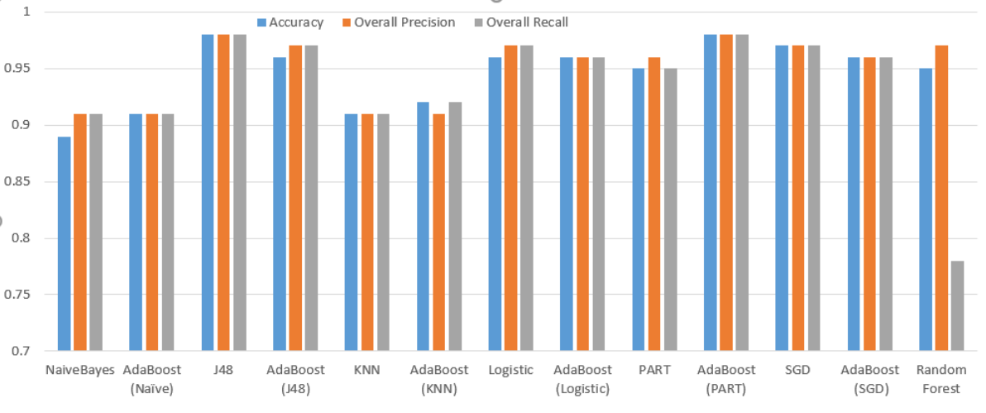
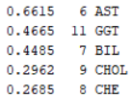
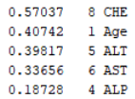



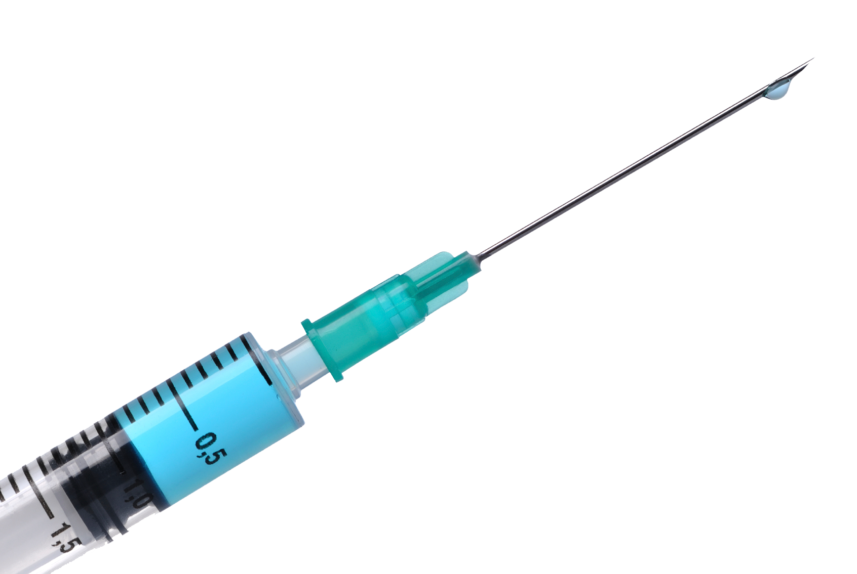
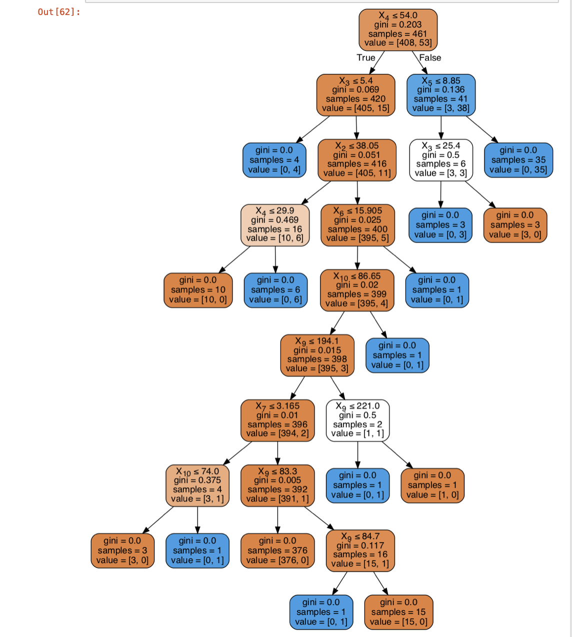
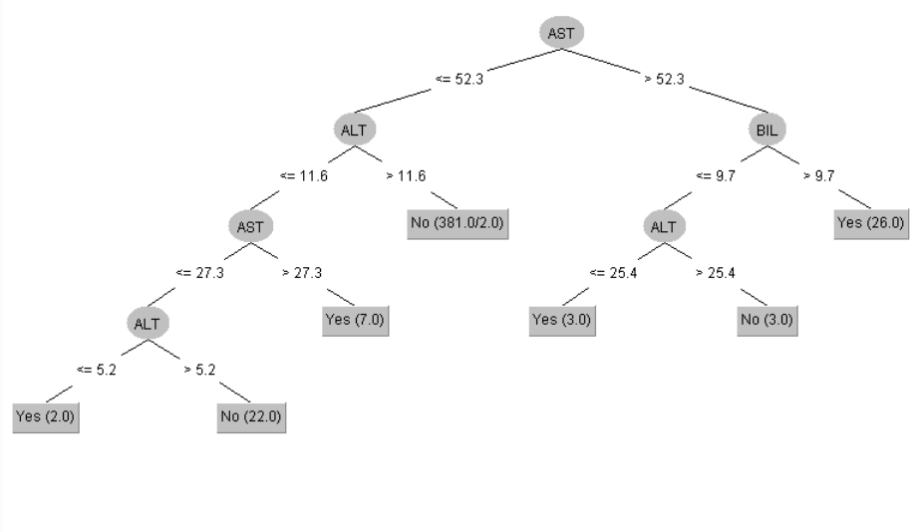
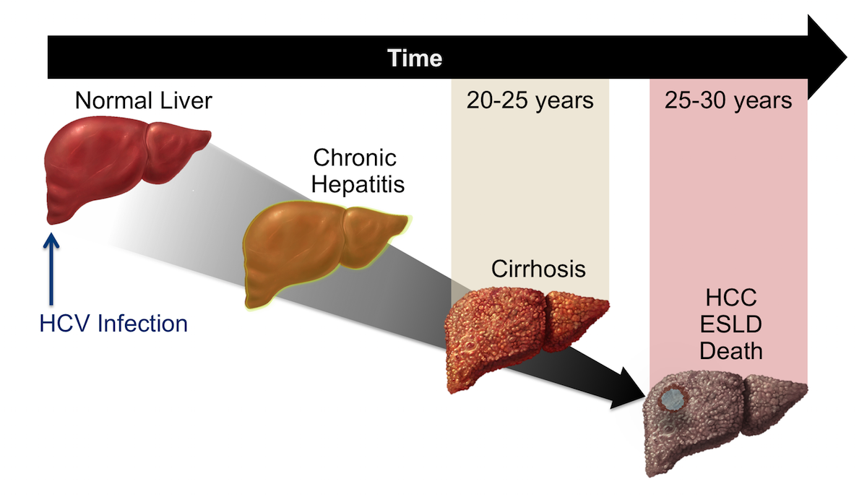
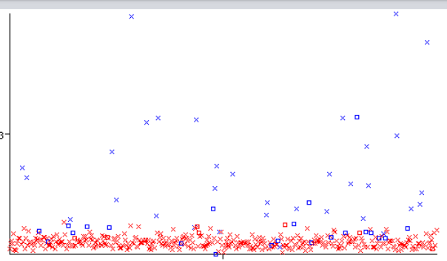
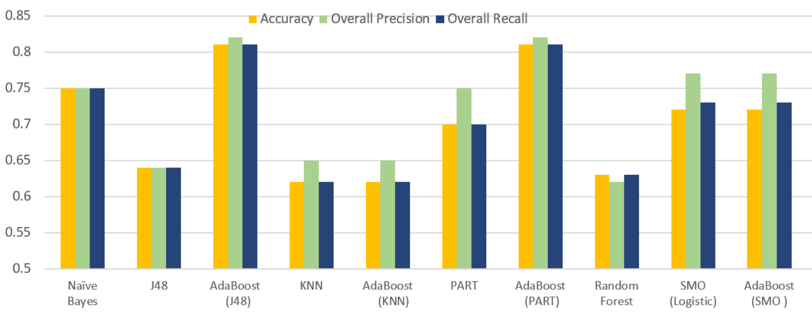
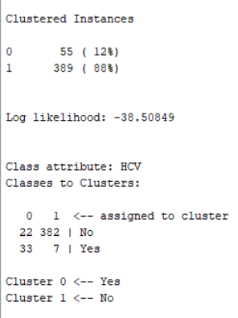
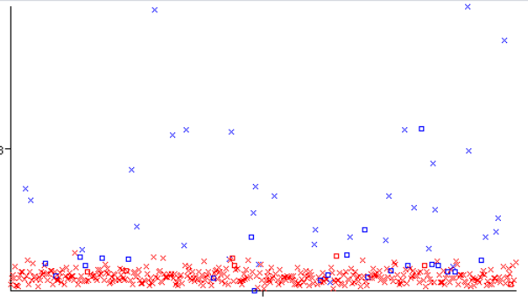
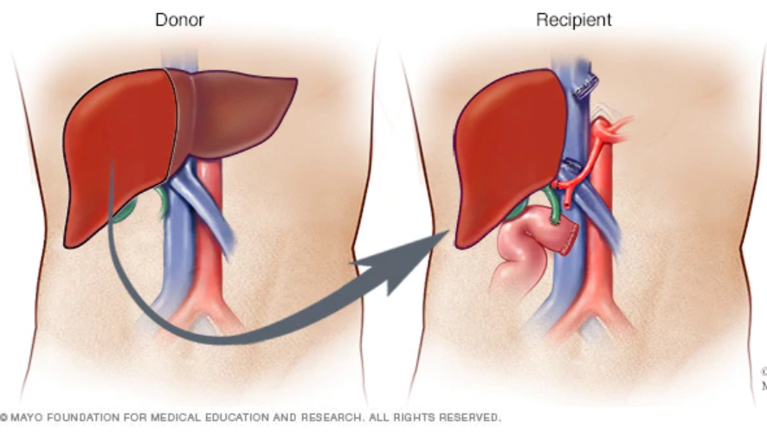
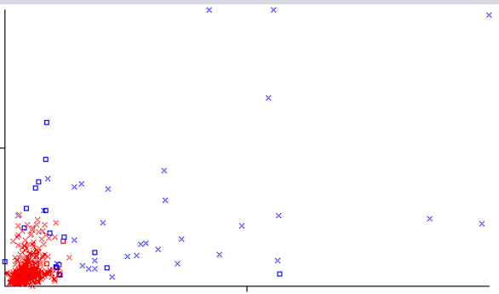


Predicting Hepatitis C Virus (HCV) using Machine Learning Model
A Data Mining Project in IS 733 – Fall 2020
Argho Sarkar Masnoon Nafees Sabrina Mamtaz-Nourin Saydeh Karabatis Simran Kaukab Shaik
Motivation
Data Knowledge
Methodologies, Results, & Conclusion
Human Body Toxin Filtering Stations
Data Pre-Processing of Blood Results
Naïve Bayes: Base classifier, assumes independence among features
KNN: Instance-based, no model, calculations on the fly based on votes of nearest neighbor
Logistic Regression: Good for binary classification and small number of features
SGD: Fast, but for small dataset: an overkill, good to try
PART: Uses Separate and Conquer based on C4.5
J48: Provides visual tree representation
Random Forest: Ensemble of trees and very popular ☺
AdaBoost: Ensemble of classifiers for each above method, increases overall accuracy
Methods for our small size dataset
Transfor-mation
Binning
Feature Selection
13x516
25
25
Healthy
13x430
25
Conversion
HCV 13x75
Outliers
Missing Values
- Hepatitis
- Fibrosis
- Cirrhosis
25
25
25
Understanding the Data
Liver
AST vs. ALT
Performance Evaluation of Classifiers for (A) on Test Data
If toxins are not removed, poison builds up in the body and creates brain malfunction leading to Encephalopathy.
Correlation with Class
Gain Ratio Attribute Eval.
Hepatitis C Virus (HCV):
Blood Transfusion
Needle Sharing
A Contracted Liver Disease
X
Data Impurity Measures (Gini Index)
X2 = Sex
X3 = ALB
X4 = ALP
X5 = ALT
X6 = AST
X7 = BIL
X9 = Chol
X10 = Crea
J48 for (A)
[10-folds CV] [C = 0.25] [M =2]
HCV-Infected Liver Degeneration
TP | 127
FN | 0
2 | FP
16 | TN
Prediction Accuracy = 98.62%
Source: WHO
Locating Clusters
Performance Evaluation of Classifiers for (B) on Test Data
- Early Intervention: Medicine
- Later Stages: Possible Liver Transplant
- Death of patient, if all options fail
Simple EM
Possible HCV Treatments
AST $∈Cluster (0,1)$
AST $\& GGT ∈Cluster (0,1)$
In this project we were able to identify:
Healthy vs. HCV-infected liver
Stages of infected liver to qualify for liver transplant
AST, ALP, BIL, & ALT values to predict HCV in the liver
J48 performed best in identifying healthy donors
AdaBoost (PART) performed best in identifying Cirrhosis for potential recipients of liver transplant
Challenges we overcame:
Small Dataset
Highly imbalanced classes
Future Work: Data augmentation techniques to address highly imbalanced classes
Conclusion
(A) Implement a machine learning prediction algorithm using results from blood tests to identify:
HCV infected subjects
Potential liver donors
(B) Identify stages of HCV infected liver:
If treatable then Medication
If Cirrhosis then liver transplant donated by the liver donors in this study
Purpose of the Project
Discovering Rules and Boundaries
-- If ‘Female’ ‘No HCV detected’ [Conf. = 0.91, Sup. = 0.1, Lift = 1.03] (ARM)
-- If AST <= 34.9 & ALT > 9.2 ‘No HCV’
[164.0/1.0] (PART)
-- If BIL > 9.6 ‘HCV detected’ [31.0/1.0] (PART)
-- SVM: 88.5% correctly classified instances
Poster Authors are grateful to:
Dr. Foulds and his guidance especially during this COVID-19 era
Drs. Lichtinghagen & etl, the authors of the UCI - HCV dataset

